Slide 1
Remote Management Forms

Slide 2
When all the remote management data is compiled, there are 1306 forms total across all diagnostic groups
Of which 746 (57%) are incomplete in terms of previous appointment date.
For the patients for whom we have a previous appointment date for (n= 554 – excluding those with a clearly incorrectly entered date e.g. in the future), we can infer ‘time spent on backlog’ as the interval in months between their previous appointment and the time of this remote management form “visit”.
The tables below show how many patients had been waiting for how many months (Table 1.), and how many patients’ remote management forms were being reviewed each 3-month quarter (starting in Nov 2020 – here called ‘2021.1’ - which is the date of the first form reviewed). See overleaf for a graph.
Table 1
Table 2

Slide 3
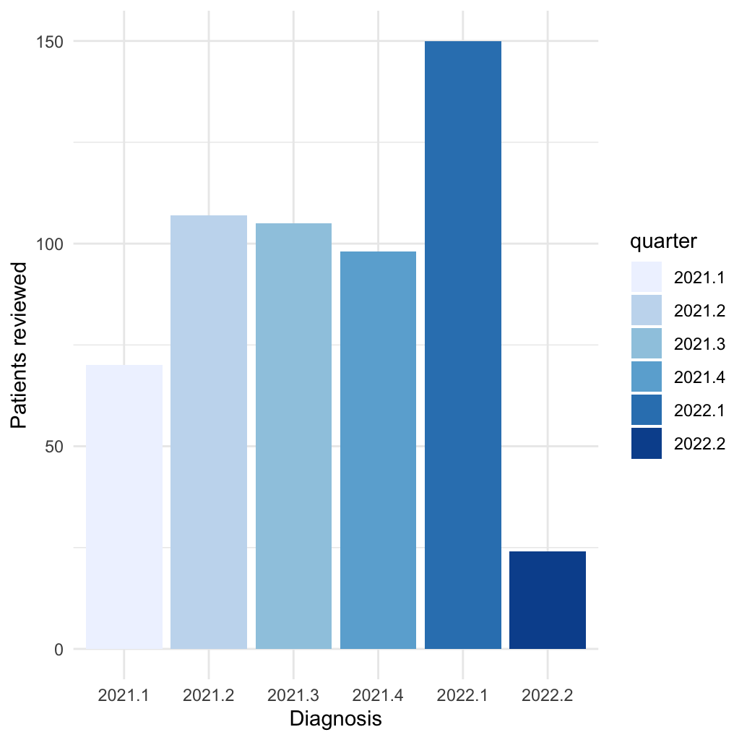

Slide 4
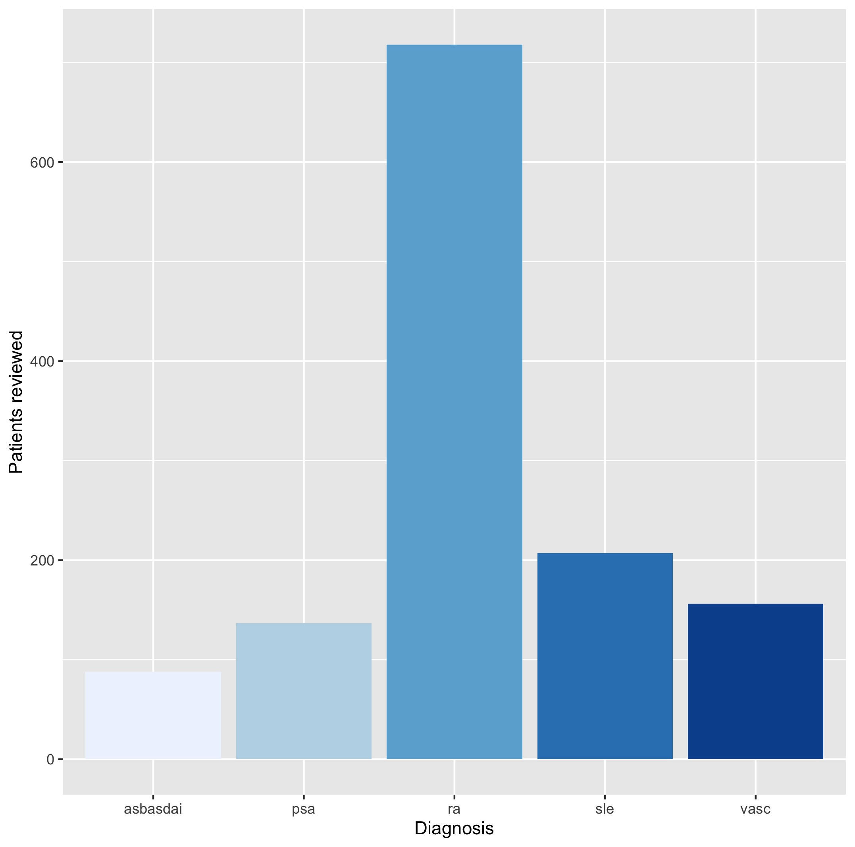
Here we see the total number of patients reviewed by remote management in each diagnostic group (total – including those with incomplete data)

Slide 5
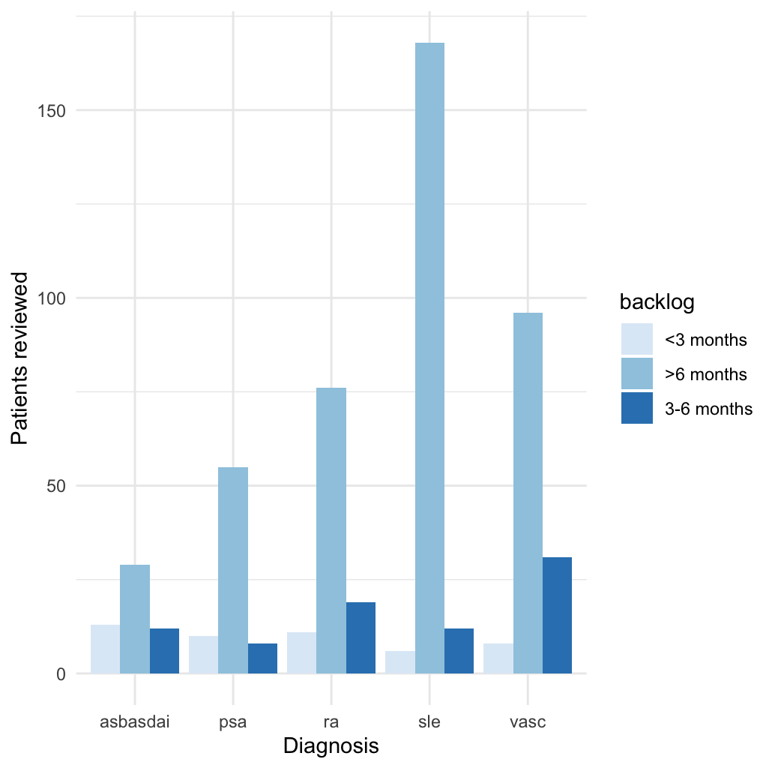
Here we can see a further breakdown by each diagnosis how many were on the backlog for how long (for the subset this data is available)

